Slide 1


<Name>
<Date>

Slide 2

Outline
Executive Summary
Introduction
Methodology
Results
Conclusion
Appendix

Slide 3
Executive Summary
Summary of methodologies
Data collection through API
Data collection with Web Scraping
Data Wrangling
Exploratory Data Analysis with SQL
Exploratory Data Analysis with Data Visualization
Interactive Visual Analytics with Folium
Machine Learning Prediction
Summary of all results
Exploratory Data Analysis
Interactive Analytics
Predictive Analytics

Slide 4
Introduction
Project background and context
Space X advertises Falcon 9 rocket launches on its website with a cost of 62 million dollars; other providers cost upward of 165 million dollars each, much of the savings is because Space X can reuse the first stage. Therefore, if we can determine if the first stage will land, we can determine the cost of a launch. This information can be used if an alternate company wants to bid against space X for a rocket launch. This goal of the project is to create a machine learning pipeline to predict if the first stage will land successfully.
Problems you want to find answers
What factors determine if the rocket will land successfully?
The interaction amongst various features that determine the success rate of a successful landing.
What operating conditions needs to be in place to ensure a successful landing program.

Slide 5

Section 1

Slide 6
Methodology
Executive Summary
Data collection methodology:
Data was collected using SpaceX API and web scraping from Wikipedia.
Perform data wrangling
Dealing with missing data
One-hot encoding was applied to categorical features
Perform exploratory data analysis (EDA) using visualization and SQL
Perform interactive visual analytics using Folium and Plotly Dash
Perform predictive analysis using classification models
How to build, tune, evaluate classification models

Slide 7
Data Collection
Request to SpaceX API
Decode the json
Web Scraping through Beautiful Soup
Extract HTML table
Convert to dataframe
Missing values
Convert HTML Table into a dataframe

Slide 8
Data Collection – SpaceX API
Present your data collection with SpaceX REST calls using key phrases and flowcharts
Add the GitHub URL of the completed SpaceX API calls notebook: https://github.com/luciabaeza13/Data-Science-IBM/blob/main/jupyter-labs-spacex-data-collection-api.ipynb
Get Request
json
Json normalize
Dataframe
Filter Falcon 9
Missing values

Slide 9
Data Collection - Scraping
Present your web scraping process using key phrases and flowcharts
Add the GitHub URL of the completed web scraping notebook, as an external reference and peer-review purpose
https://github.com/luciabaeza13/Data-Science-IBM/blob/main/jupyter-labs-webscraping.ipynb
Request Falcon 9 Wiki page from its URL
BeautifulSoup object from HTML response
Extract column/ variables names from HTML table header
Create a dataframe from HTML tables

Slide 10
Data Wrangling
Read csv
Percentage of missing data in each attribute
Number of launches on each site
Number and occurrence of each orbit
Number and occurrence of misión outcome ot the orbits
Landing outcome label from Outcome column
https://github.com/luciabaeza13/Data-Science-IBM/blob/main/labs-jupyter-spacex-Data%20wrangling.ipynb

Slide 11
EDA with Data Visualization
Summarize what charts were plotted and why you used those charts
Cat plot and Scatter plot. I chose these graphs because it is easy to visualize the relationship between variables.
Bar plot. I chose the graph to study the relationship between a continuos and categorical variables
Add the GitHub URL of your completed EDA with data visualization notebook, as an external reference and peer-review purpose:
https://github.com/luciabaeza13/Data-Science-IBM/blob/main/edadataviz.ipynb

Slide 12
EDA with SQL
Using bullet point format, summarize the SQL queries you performed
Names of unique launch sites in the space mission
5 records where launch sites begin with the string CCA
Total payload mass carried by boosters launched by NASA (CRS)
Average payload mass carried booster version F9 v1.1
Date when the firt successful landing outcome in ground pad
Names of the boosters which have success in drone ship and have payload mass greater than 4000 but less than 6000
Total number of successful and failure mission outcomes
Records which will display the month names, failure landing outcomes in drone ship booster version, launch site for the months in year 2015
Count the landing outcomes such as Failure (drone ship) or success (ground pad) between the date 2010-06-04 and 2017-03-20
https://github.com/luciabaeza13/Data-Science-IBM/blob/main/jupyter-labs-eda-sql-coursera_sqllite.ipynb

Slide 13
Build an Interactive Map with Folium
I marked all launch sites, and added map objects such as markers, circles, lines to mark the success or failure of launches for each site on the folium map.
I assigned the feature launch outcomes (failure or success) to class 0 and 1.i.e., 0 for failure, and 1 for success.
Using the color-labeled marker clusters, we identified which launch sites have relatively high success rate.
Add the GitHub URL of your completed interactive map with Folium map, as an external reference and peer-review purpose:
https://github.com/luciabaeza13/Data-Science-IBM/blob/main/jupyter-labs-spacex-data-collection-api.ipynb

Slide 14
Build a Dashboard with Plotly Dash
We built an interactive dashboard with Plotly dash
We plotted pie charts showing the total launches by a certain sites
We plotted scatter graph showing the relationship with Outcome and Payload Mass (Kg) for the different booster version.

Slide 15
Predictive Analysis (Classification)
We loaded the data using numpy and pandas, transformed the data, split our data into training and testing.
We built different machine learning models and tune different hyperparameters using GridSearchCV.
We used accuracy as the metric for our model, improved the model using feature engineering and algorithm tuning.
We found the best performing classification model.
https://github.com/luciabaeza13/Data-Science-IBM/blob/main/SpaceX_Machine%20Learning%20Prediction_Part_5.ipynb

Slide 16
Results
Exploratory data analysis results
Interactive analytics demo in screenshots
Predictive analysis results

Slide 17

Section 2

Slide 18
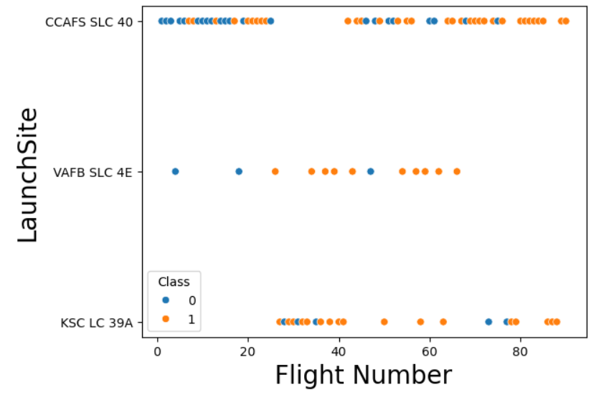
Flight Number vs. Launch Site

Slide 19
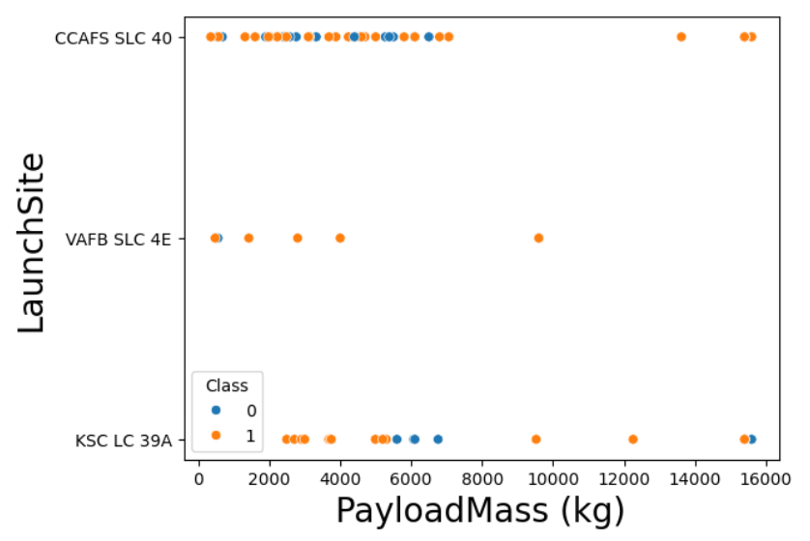
Payload vs. Launch Site

Slide 20
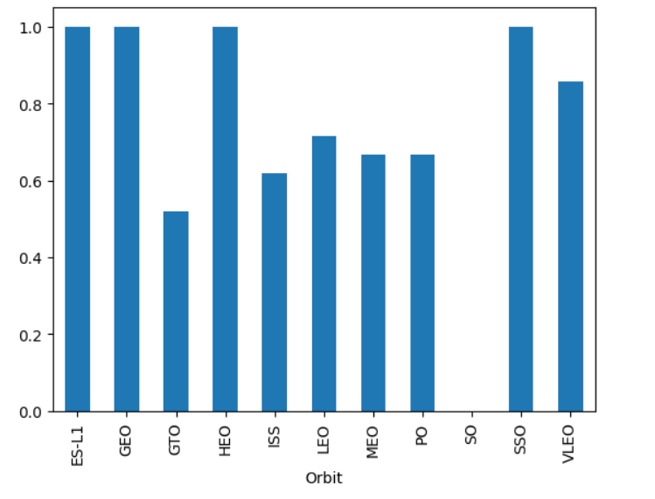
Success Rate vs. Orbit Type

Slide 21
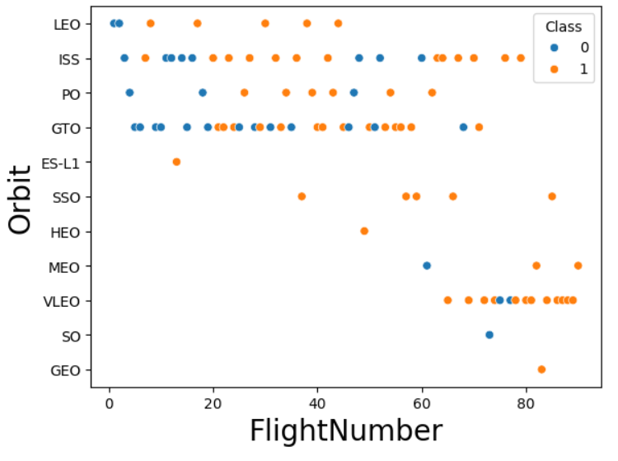
Flight Number vs. Orbit Type

Slide 22
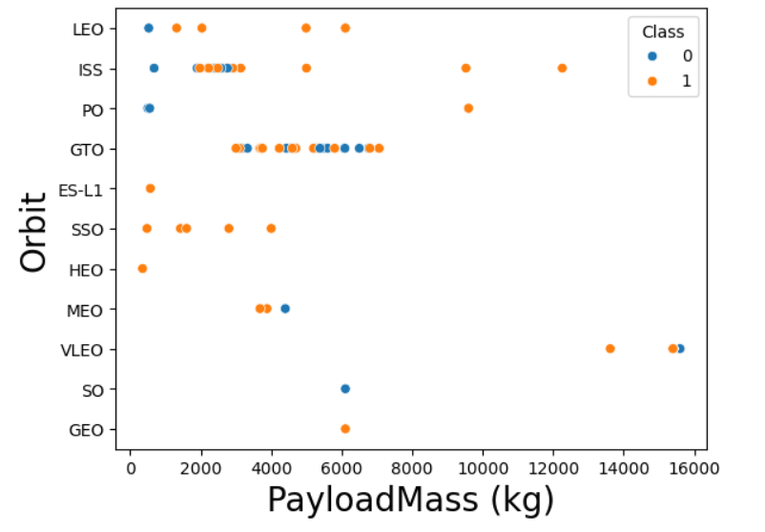
Payload vs. Orbit Type

Slide 23

Launch Success Yearly Trend

Slide 24
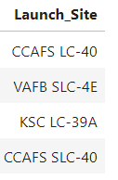
All Launch Site Names
Find the names of the unique launch sites
We used the key word DISTINCT to show only unique launch sites from the SpaceX data.

Slide 25
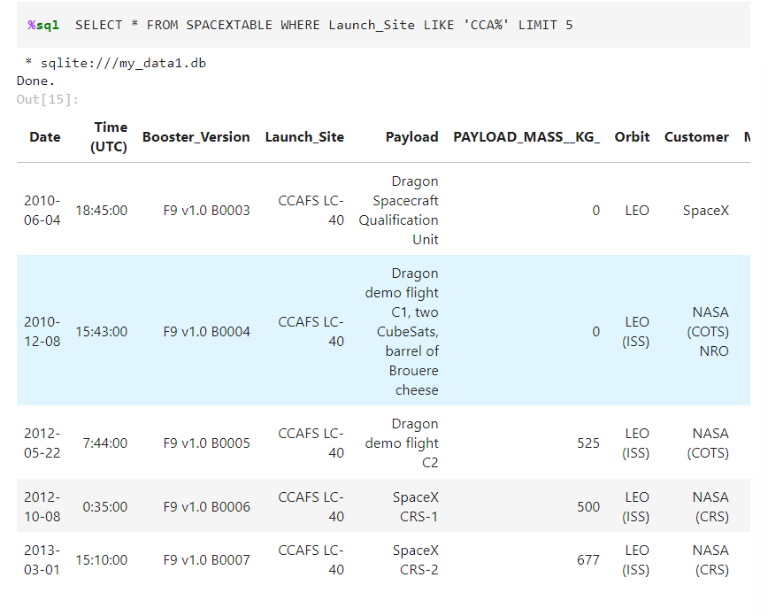
Launch Site Names Begin with 'CCA'
We used LIMIT for choose 5 rows

Slide 26
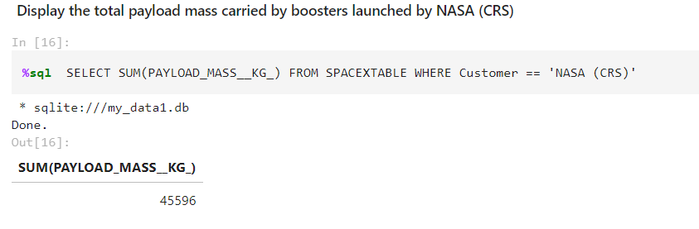
Total Payload Mass
Calculate the total payload carried by boosters from NASA
We used SUM for obtain the total payload

Slide 27
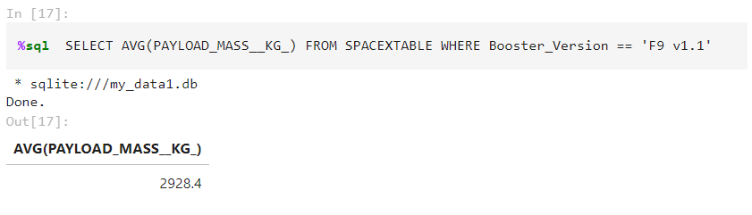
Average Payload Mass by F9 v1.1
Calculate the average payload mass carried by booster version F9 v1.1
We used AVG for obtain the average payload mass

Slide 28
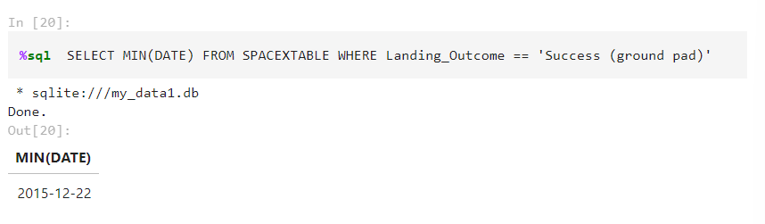
First Successful Ground Landing Date
Find the dates of the first successful landing outcome on ground pad
We used MIN for select the first successful landing

Slide 29
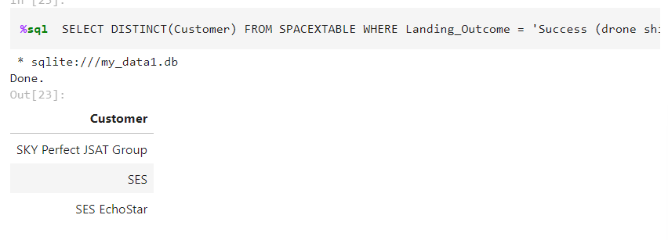
Successful Drone Ship Landing with Payload between 4000 and 6000
List the names of boosters which have successfully landed on drone ship and had payload mass greater than 4000 but less than 6000
We used DISTINCT for select unique values

Slide 30
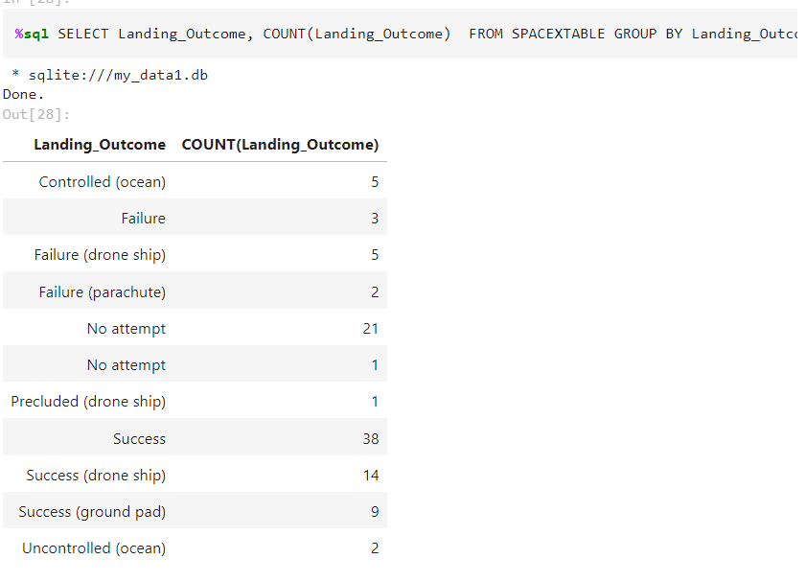
Total Number of Successful and Failure Mission Outcomes
We select Count for count values of landing outcomes

Slide 31
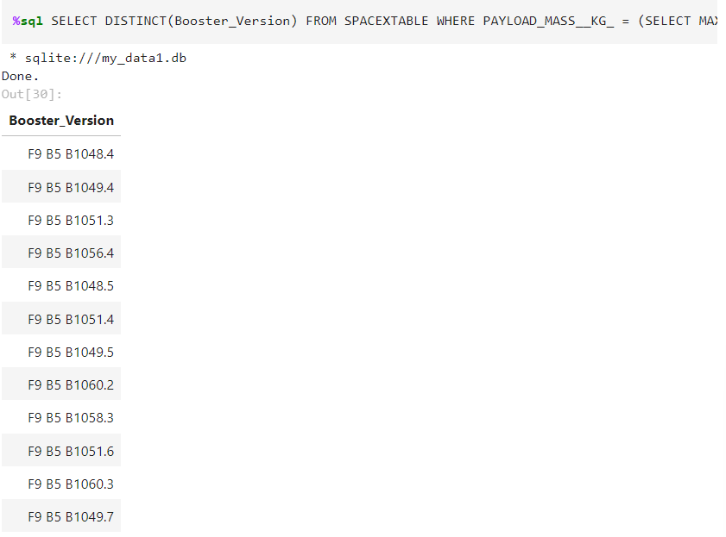
Boosters Carried Maximum Payload
We used DISTINCT for list different values

Slide 32
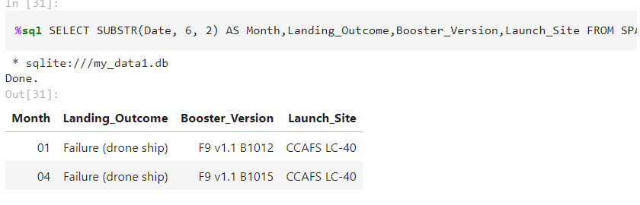
2015 Launch Records
List the failed landing_outcomes in drone ship, their booster versions, and launch site names for in year 2015
Present your query result with a short explanation here

Slide 33
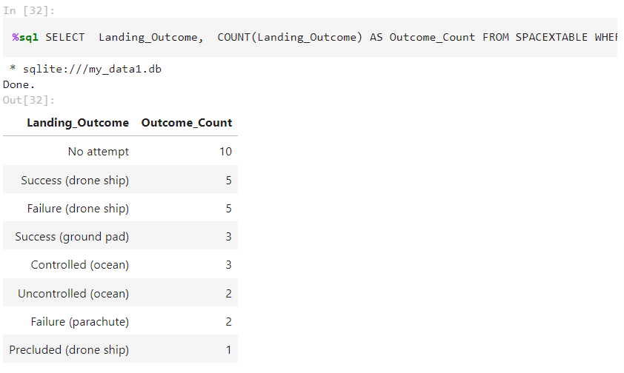
Rank Landing Outcomes Between 2010-06-04 and 2017-03-20
We used COUNT for count values of landig outcomes

Slide 34

Section 3

Slide 35

<Launch sites>

Slide 36

<Launch sites with color labels>

Slide 37

<Site distance>

Slide 38

Section 5

Slide 39
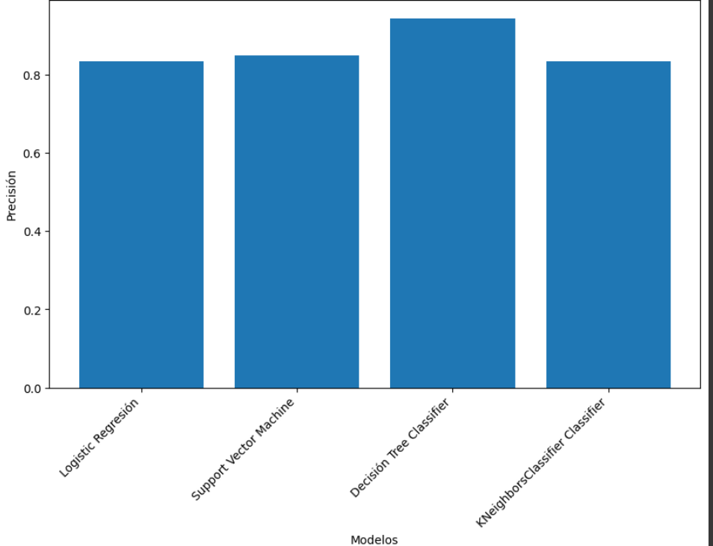
Classification Accuracy

Slide 40
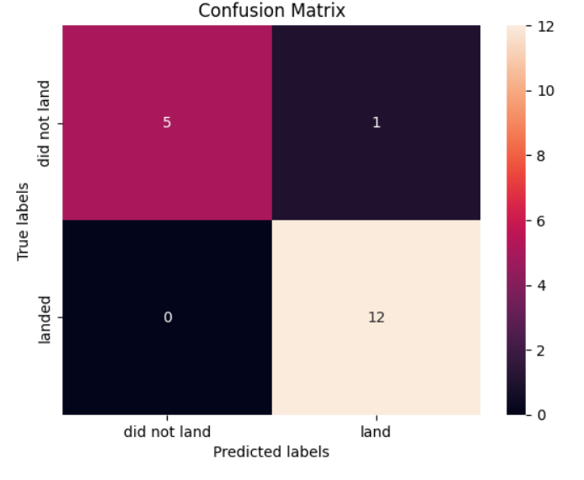
Confusion Matrix
Show the confusion matrix of the best performing model with an explanation

Slide 41
Conclusions
The decision tree classifier is the model with the highest classification accuracy
The larger the flight amount at a launch site, the greater the success rate at a launch site.
Launch success rate started to increase in 2013 till 2020.
Orbits ES-L1, GEO, HEO, SSO, VLEO had the most success rate.

Slide 42


